Slide 1
BIA 650
Process Innovation and Management
8 – GeneticAlgorithms/Neural Nets
Definitions – Genetic Algorithms
Running “Evolver” in Excel
Case Study: Forming Teams
GA: Discriminant Analysis, Cluster Analysis
Neural Net Demonstration
© E. A. Stohr, 2018
Notes:
Up to this point, we have been concerned with choosing & designing business processes.
In this lecture, we look at:
Simulation: How to check alternative process designs
WFMS: How to automate processes
Since not all processes can be expressed as fixed workflows, we also look at:
Groupware: How to support coordination in unstructured situations
Finally, we look at 2 real case studies involving the implementation of a WFMS

Slide 2
Genetic Algorithms
There are many optimization problems where Solver’s Simplex LP and GRG Nonlinear algorithms are unable to find optimal solutions.
Genetic algorithms (GAs) often perform well on optimization problems where Solver’s other algorithms perform poorly. GAs find good (close to optimal) solutions to very difficult problems where the objective cell and/or constraints are “non-smooth” functions of the changing cells. The GA is a method of intelligently searching a model’s feasible region for an optimal solution.
GAs use the method of “survival of the fittest” from nature.
Solver for Excel 2010 includes the Evolutionary algorithm

Slide 3
Genetic Algorithms
Biological terminology is used to describe the algorithm.
  The objective function is called a fitness function.
  Specification of values for all changing cells is called a chromosome. This represents a trial solution.
  For most problems, a GA codes changing cells in binary notation. For example, 1001 represents
    1(2³) + 0(2²) + 0(2¹) + 1(2⁰) = 8 + 1 = 9
  Sometimes, one designs one’s own encoding for a chromosome as illustrated below.

Slide 4
Properties of a GA
GA is guaranteed to find the solution to any optimization problem, but it might take forever. Need to run for minutes (our problems) or hours. Stop after a fixed time period or if very little improvement occurs from one iteration to the next.
Unfortunately, you do not know if the best solution you have found is optimal, but it is usually a good solution - that is, very close to being optimal.
GAs do very well in problems with a few constraints (excluding bounds on changing cells). But take a long time if there are many constraints.
The complexity of the objective does not bother a GA, which can easily handle MIN, MAX, IF, and ABS functions in spreadsheet models. This is the key advantage of GAs.

Slide 5
Properties of a GA (Cont’d)
The solution process uses random numbers to direct the search. Hence, running Evolutionary Solver a second time can possibly yield a different solution! You can set a random seed parameter to get the same solution on two successive runs.
Often can use GRG to test and possibly improve the results of a GA.

Slide 6
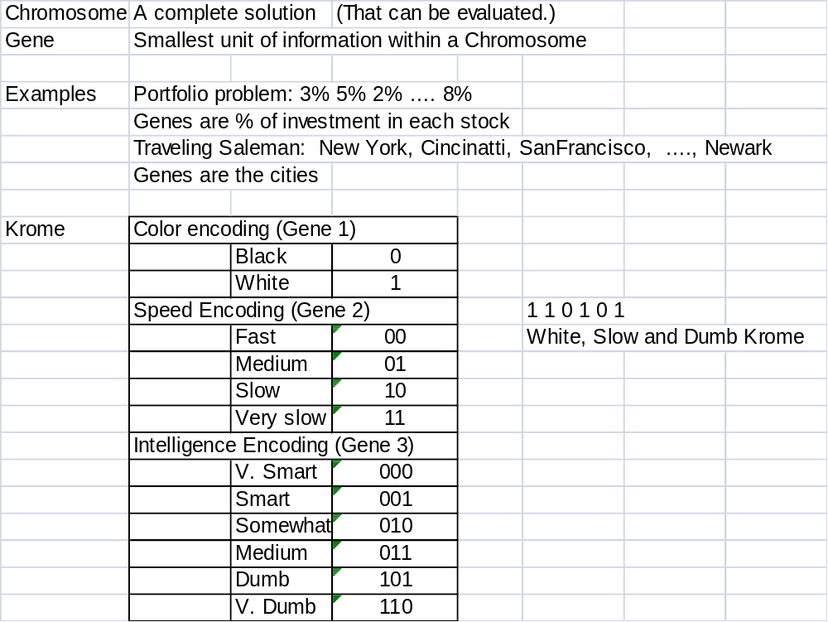
Chromosomes and Genes

Slide 7
Genetic Algorithm
Start with a large population, N, of random chromosomes. Each one, represents a different solution to the problem at hand.
Test each chromosome to see how good it is at solving the problem at hand and assign a fitness score accordingly. The fitness score is a measure of how good that chromosome is at solving the problem to hand.
Select two members from the current population. The chance of being selected is proportional to the chromosomes fitness. Roulette wheel selection is a commonly used method.
Dependent on the crossover rate, crossover the bits from each chosen chromosome at a randomly chosen point.
Step through the chosen chromosomes bits and flip dependent on the mutation rate.
Repeat step 2, 3, 4 until a new population of N members has been created.

Slide 8
Genetic Algorithm Operators
Chromosomes: A possible solution. In binary coding, we might have:
  Chromosome 1: 1101100100110110
  Chromosome 2: 1101111000011110
Crossover selects genes from parent chromosomes and creates a new offspring. Choose randomly some crossover point and copy everything before this point from a first parent and then copy everything after the crossover point copy from the second parent. ( | is the crossover point):
Chromosome1 11001 | 00100110110
Chromosome2 11011 | 11000011110
Offspring 1 11001 | 11000011110
Offspring 2 11011 | 00100110110
Simulation:
http://www.obitko.com/tutorials/genetic-algorithms/example-function-minimum.php

Slide 9
Genetic Algorithms
Cross-over Example
Suppose one has a two variable optimization problem – say optimizing a complex production function for 2 products Q1 and Q2. Then the chromosome consists of trial solutions for Q1 and Q2 and it may make sense to breed these separately – of course, through the objective (fitness) function non-linear dependencies are captured. (See W&A, Chapter 8)
Two members of the initial population might be:
Chromosome 1:
Q1 = 100 -- 0011|00100 and Q2 = 400 -- 1100|00000
Chromosome 2:
Q1 = 300 -- 1001|01100 and Q2 = 200 -- 0110|01000
Offspring are:
New Chromosome 1:
Q1 = 100 -- 1001|00100 and Q2 = 400 -- 0110|0000
New Chromosome 2:
Q1 = 300 -- 0011|01100 and Q2 = 200 -- 1100|01000

Slide 10
Genetic Algorithm Operators
Mutation. For binary encoding we can switch a few randomly chosen bits from 1 to 0 or from 0 to 1. Mutation could be as follows:
Original offspring 1 1101111000011110
Original offspring 2 1101100100110110
Mutated offspring 1 1100111000011110
Mutated offspring 2 1101101100110110
Mutations are generally used only occasionally. They allow the GA to explore a completely different region of the solution space.

Slide 11
Pseudo Random Numbers (an Aside)
Making a deterministic computer generate random numbers.
r_{n+1} = (A × r_{n} + B) mod M
A, B and M are suitably chosen large numbers.
The “seed”, r₀, can be chosen optionally. This can be useful for variance reduction in simulation experiments. If you run the same system twice with different policy choices, you can set r₀ to the same number in each experiment. In affect, this means that each policy is tested against the same random number stream.
All computer languages have a function (say) rnd() that returns a random number in the range (0,1), thereby generating a uniform probability distribution:
Prob
1
1

Slide 12
Example Genetic Algorithm
Sample Problem --- adapted from
http://www.ai-junkie.com/ga/intro/gat3.html
Given the digits 0 through 9 and the operators +, -, * and /, find a sequence that will represent a given target number. The operators will be applied sequentially from left to right.
Given the target number 23, the sequence 6+5*4/2+1 would be one possible solution.
If 75.5 is the chosen number then 5/2+9*7-5 would be a possible solution.

Slide 13
Example of a Genetic Algorithm
Stage 1: Encoding: To represent all the different characters available to the solution... that is 0 through 9 and +, -, * and /. This will represent a gene. Each chromosome will be made up of several genes.
Four bits are required to represent the range of characters used:
0: 0000
1: 0001
2: 0010
3: 0011
4: 0100
5: 0101
6: 0110
7: 0111
8: 1000
9: 1001
+: 1010
-: 1011
*: 1100
/: 1101
The possible genes 1110 & 1111 are not used and will be ignored.

Slide 14
Sample Problem – Cont’d
The solution for 23, ' 6+5*4/2+1' would be represented by nine genes:
0110 1010 0101 1100 0100 1101 0010 1010 0001
6 + 5 * 4 / 2 + 1
If a nonsense chromosome appears, for example:
0010001010101110101101110010
Representing:
2 2 + n/a - 7 2
We ignore it. In fact, ignore any chromosome that does not follow the pattern:
number -> operator -> number -> operator …

Slide 15
Sample Problem – Cont’d
Stage 2: Fitness Function
A fitness score can be assigned that is inversely proportional to the difference between the solution and the value that a decoded chromosome represents (the larger the better). If 23 is the target:
number -> operator -> number -> operator number -> operator -> number
0110 1010 0101 1100 0110 1101 0010 1010 0001
6 + 5 * 6 / 2 + 1 = 34
has a fitness score of 1/(34-23) or 1/11.
If the exact solution is found, a divide by zero error would occur as the fitness would be 1/(23-23). (Need to test for this.)

Slide 16
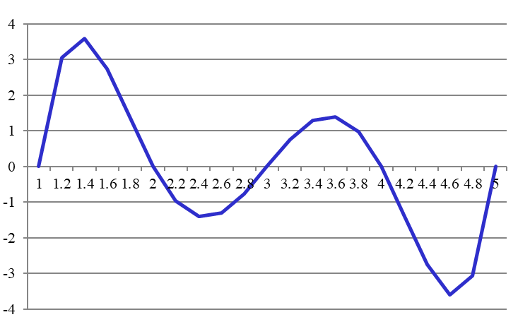
Running Excel’s Evolver
Genetic Algorithm Demonstration
Function with local maxima
Max z= (x-1)(x-2)(x-3)(x-4)(x-5)
x | Product Value
 | 3.631432
1 | 0
1.2 | 3.06432
1.4 | 3.59424
1.6 | 2.74176
1.8 | 1.35168
2 | 0
2.2 | -0.96768
2.4 | -1.39776
2.6 | -1.29024
2.8 | -0.76032
3 | 0
3.2 | 0.76032
3.4 | 1.29024
3.6 | 1.39776
3.8 | 0.96768
4 | 0
4.2 | -1.35168
4.4 | -2.74176
4.6 | -3.59424
4.8 | -3.06432
5 | 0

Slide 17
Running Excel’s Evolver
Genetic Algorithm Demonstration
Function with local maxima
Max z= (x-1)(x-2)(x-3)(x-4)(x-5)
x | 1.355567
x-1 | 0.355567
x-2 | -0.64443
x-3 | -1.64443
x-4 | -2.64443
x-5 | -3.64443
Product | 3.631432
=Product(B6:B10)

Slide 18
Case 8.1 Constructing Teams
MBA Program at State University
Must assign students to 14 teams. Each team must have:
  4 or 5 members
and at least:
  one member with a CPA
  one quant
  one female
  one international student

Slide 19
Case 8.1 Constructing Teams
Student | CPA? | Quant? | Female? | Minority? | Foreign? |  | Student | Teams |  | Team | Members | CPAs | Quants | Females | Minorities | Foreigns
1 | 0 | 0 | 1 | 0 | 0 |  | 1 | 14 |  | 1 | 1 | 1 | 1 | 1 | 1 | 1
2 | 0 | 0 | 0 | 0 | 0 |  | 2 | 11 |  | 2 | 1 | 1 | 1 | 1 | 1 | 1
3 | 1 | 0 | 1 | 0 | 0 |  | 3 | 12 |  | 3 | 1 | 1 | 1 | 1 | 1 | 1
4 | 0 | 0 | 1 | 0 | 0 |  | 4 | 12 |  | 4 | 1 | 1 | 1 | 1 | 1 | 1
5 | 0 | 1 | 0 | 0 | 0 |  | 5 | 4 |  | 5 | 1 | 1 | 1 | 1 | 1 | 1
6 | 1 | 0 | 0 | 0 | 1 |  | 6 | 2 |  | 6 | 1 | 1 | 1 | 1 | 1 | 1
7 | 0 | 1 | 0 | 1 | 0 |  | 7 | 2 |  | 7 | 1 | 1 | 1 | 1 | 1 | 1
8 | 0 | 1 | 0 | 0 | 0 |  | 8 | 1 |  | 8 | 1 | 1 | 1 | 1 | 1 | 1
9 | 0 | 0 | 0 | 0 | 1 |  | 9 | 3 |  | 9 | 1 | 1 | 1 | 1 | 1 | 1
10 | 0 | 1 | 0 | 0 | 1 |  | 10 | 9 |  | 10 | 1 | 1 | 1 | 1 | 1 | 1
11 | 1 | 0 | 0 | 0 | 1 |  | 11 | 1 |  | 11 | 1 | 1 | 1 | 1 | 1 | 1
12 | 0 | 0 | 0 | 1 | 0 |  | 12 | 8 |  | 12 | 1 | 1 | 1 | 1 | 1 | 1
13 | 0 | 1 | 1 | 0 | 0 |  | 13 | 2 |  | 13 | 1 | 1 | 1 | 1 | 1 | 1
14 | 1 | 0 | 0 | 0 | 0 |  | 14 | 7 |  | 14 | 1 | 1 | 1 | 1 | 1 | 1
15 | 0 | 0 | 0 | 0 | 0 |  | 15 | 13
16 | 0 | 1 | 0 | 0 | 0 |  | 16 | 11 |  | Penalty | 0 | 0 | 0 | 0 | 0 | 0
17 | 0 | 1 | 0 | 0 | 0 |  | 17 | 8 |  | Weight | 1 | 1 | 1 | 1 | 1 | 1
18 | 0 | 0 | 0 | 0 | 0 |  | 18 | 5
19 | 0 | 0 | 1 | 0 | 0 |  | 19 | 5 |  | Total | 0
20 | 0 | 1 | 1 | 0 | 1 |  | 20 | 7 |  | Penalty
21 | 0 | 1 | 0 | 1 | 0 |  | 21 | 13
22 | 0 | 1 | 0 | 1 | 1 |  | 22 | 12
=IF(AND(COUNTIF(Teams,K5)>=4,COUNTIF(Teams,K5)<=5),1,0)
=IF(SUMIF(Teams,$K5,B$5:B$69)>=1,1,0)
=14-SUM(L5:L18)

Slide 20
Genetic Algorithms
Dimension | Genetic Algorithm | But ..
Accuracy | Low to high
Explainability | Low
Response speed | Moderate | Varies with complexity
Scalability | Moderate | Bounded by length of chromosome
Flexibility | High | Easy to apply
Limitations | Low | Does not handle constraints well
Ease of use | High

Slide 21
Genetic Algorithms
References:
http://www.obitko.com/tutorials/genetic-algorithms/
Vasant Dhar and Roger Stein (1997). Seven methods for transforming corporate data into business intelligence. Upper Saddle River: Prentice Hall.

